Slide 1
Transaksi Aman di eCommerce ?
Kenapa Gak…

Slide 2

Pull Market

Slide 3
Wajah Dunia Online Indonesia
POPULATION
INTERNET USER 2013
242,3 Million
72,7 Million
INTERNET PENETRATION 2013
URBAN INTERNET PENETRATION
29%
57%
SMARTPHONE USER
SMARTPHONE PENETRATION
38,5 Million
24%

Slide 4
Media Sosial (masih) Jadi Favorit…
20%
START BUY THROUGH
SOCIAL MEDIA
SHOPPERS PREFER BUYING
PRODUCT THROUGH BRAND’S FACEBOOK PAGE COMPARED TO IT’S WEBSITE
SOURCE : MASHABLE.COM/2012/11/01FACEBOOK-SALES
SOCIAL MEDIA
IS HUGE
IN INDONESIA

Slide 5
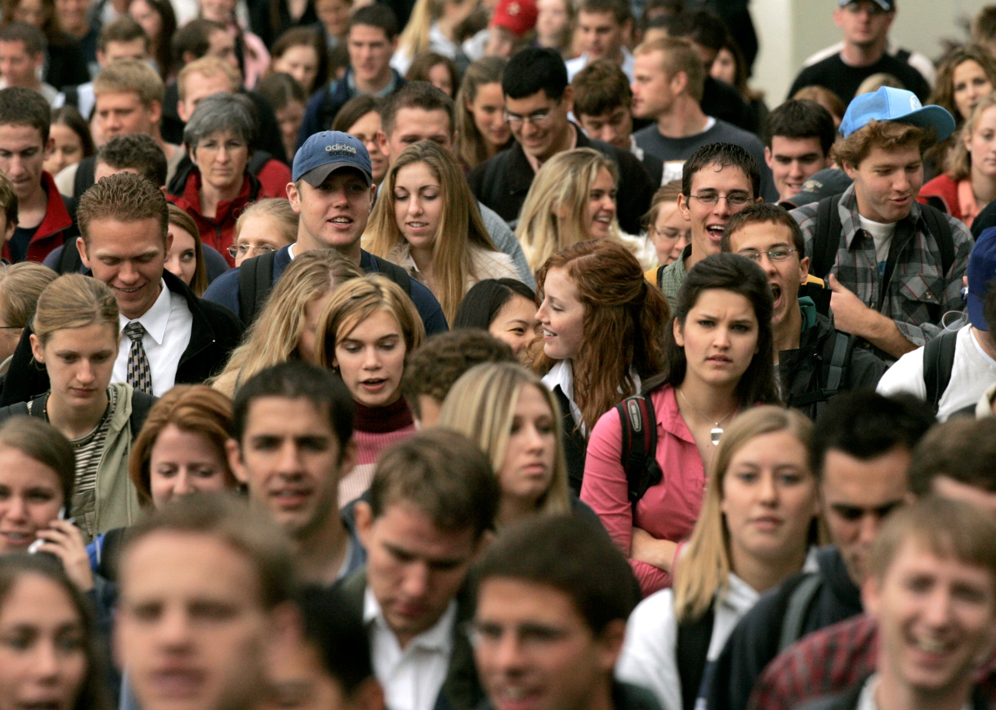
Kamu ada di Mana..?

Slide 6
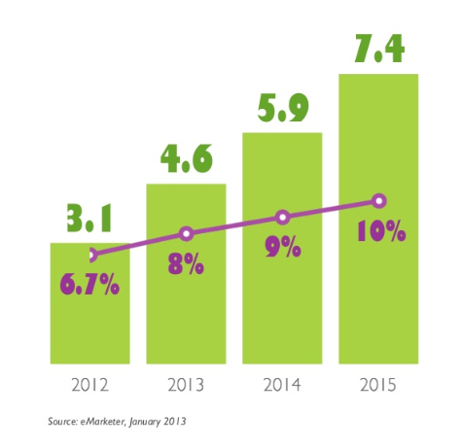
Pasar Digital Indonesia
Pebelanja Online
Pengguna internet
dalam %

Slide 7
Interaksi + Transaksi = Konversi

Slide 8
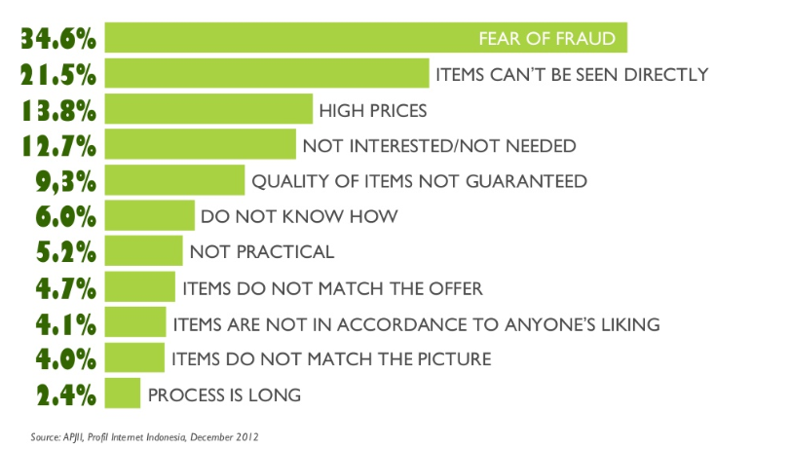
Kenapa Mereka Takut Bertransaksi Online…?

Slide 9
Jangan Takut Bertransaksi Online, Asal…?
Reliable
Competence
- Teknologi
- Penanganan User
- Partner Perbankan
- Penanganan Transaksi
- Partner Lintas Industri
- Penanganan Kebijakan (BI)
Payment Online
SECURE
Dynamic
User Friendly
- Ecosystem Support
- User Dashboard
- Technology Innovation
User Experience
  Transparent
  Execute
- Mix Channel Distribution
- Integration

Slide 10
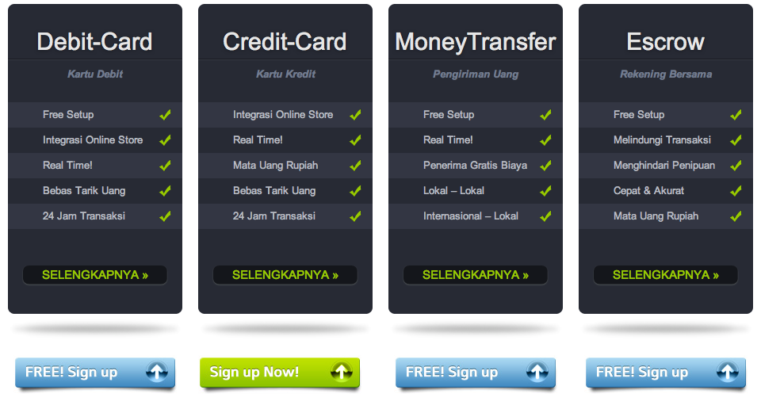
Inikah yang kamu Butuhkan…?

Slide 11
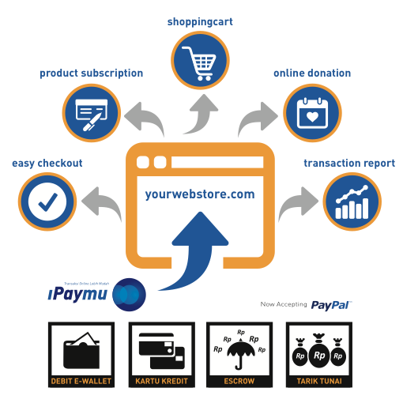
Sepenuhnya mendukung KONVERSI
EASY, OPEN SOURCE (API), PLUG & PLAY
Integrated System for Webstore

Slide 12



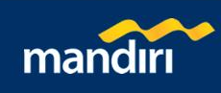
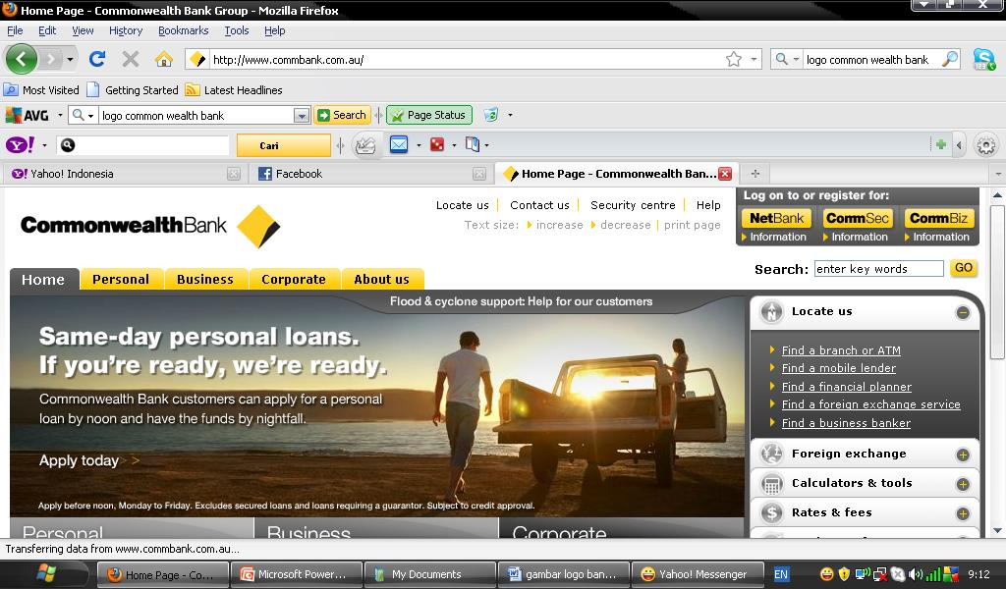
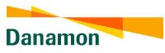
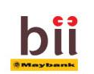
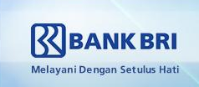
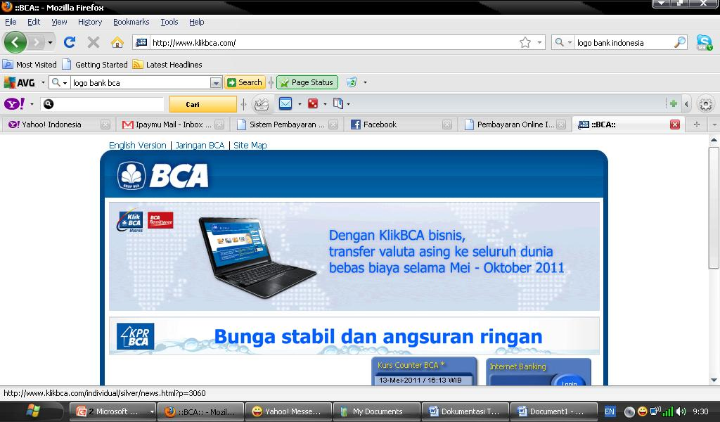
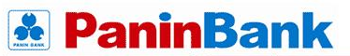

1 Pintu ke 137 Bank di Indonesia…
With Only
1% fee/transaction

