Slide 1



Slide 2


Slide 3
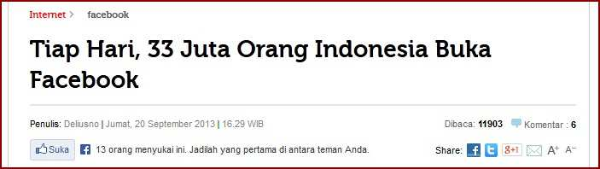
Intro
http://tekno.kompas.com/read/2013/09/20/1629066/tiap.hari.33.juta.orang.indonesia.buka.fa

Slide 4
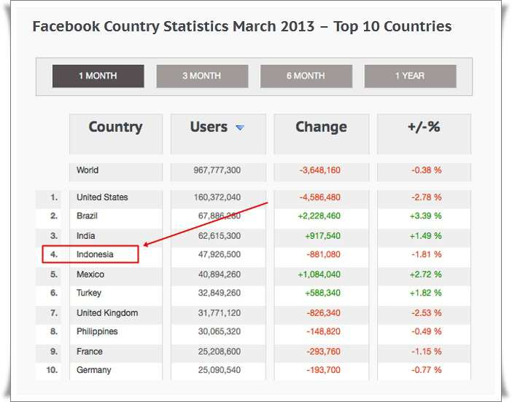

Slide 5
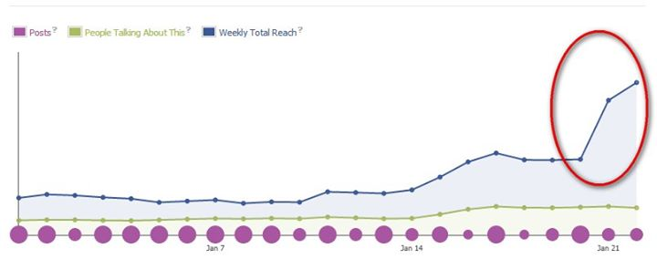
Bukti (Sombooong)

Slide 6
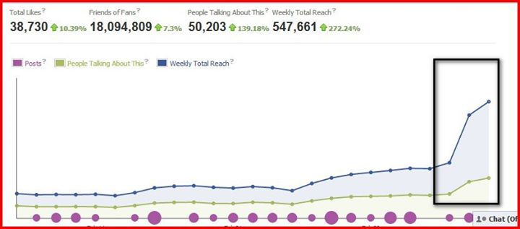

Slide 7
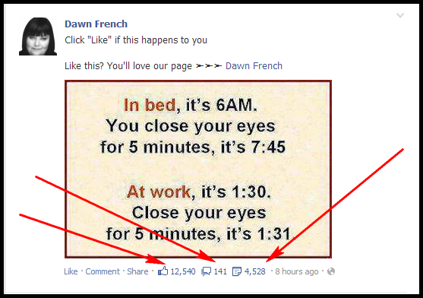
Why Facebook?!

Slide 8
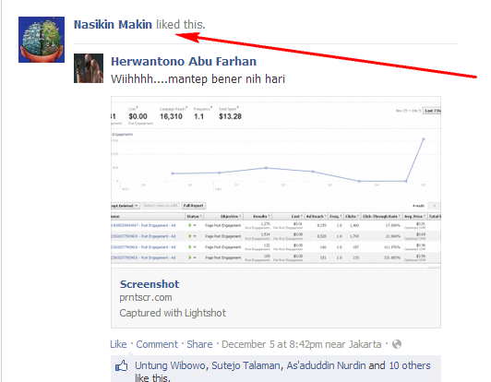

Slide 9
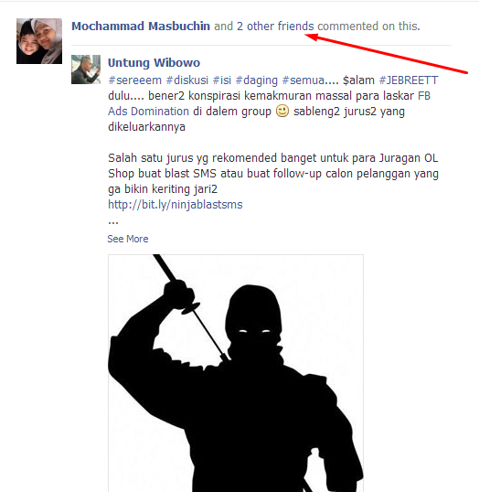

Slide 10
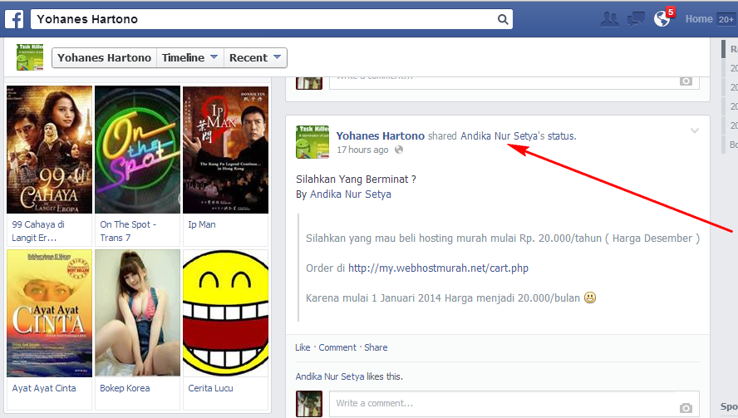

Slide 11
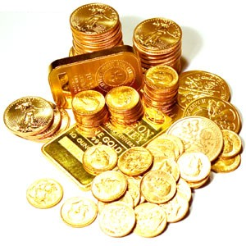
Asset on Facebook!
Akun FB
Group FB
Fan Page

Slide 12

Choose Fan Page Dud!

Slide 13
Why Fan Page???
Terukur
Pilihan Mudah dalam beriklan
Multi Owner
Threaded Comment

Slide 14
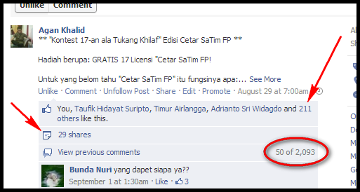
Terukur

Slide 15
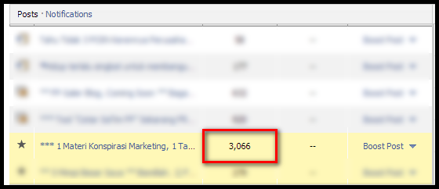

Slide 16
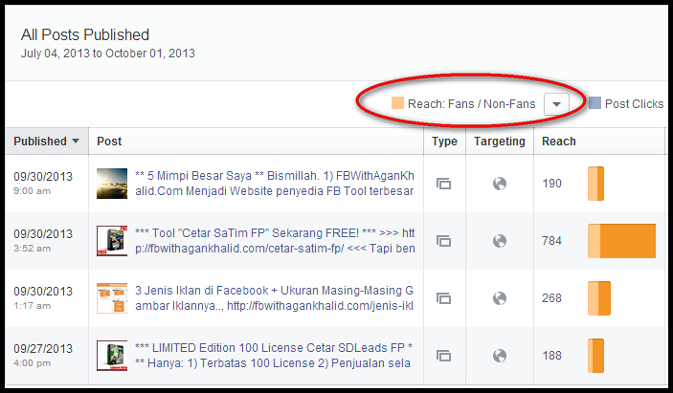

Slide 17

Pilihan Mudah dalam beriklan

Slide 18
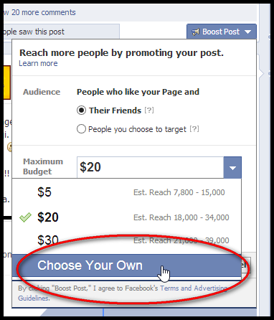

Slide 19
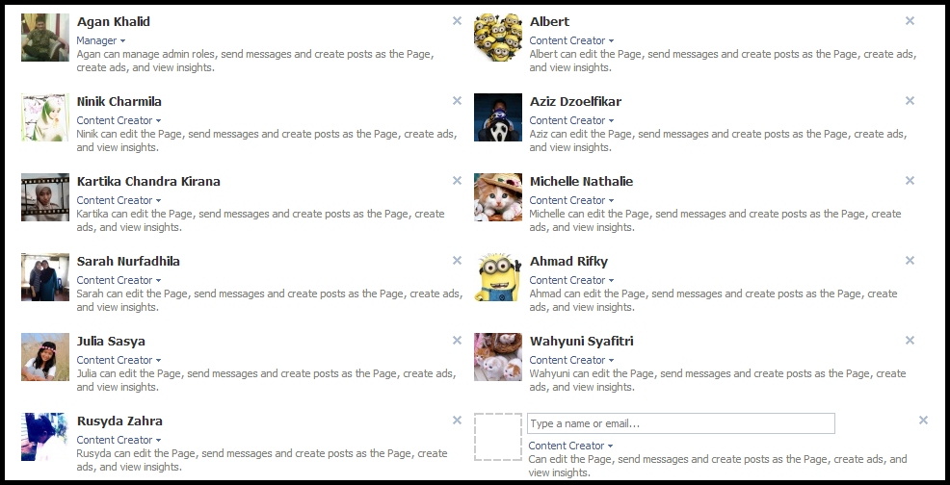
Multi Owner

Slide 20
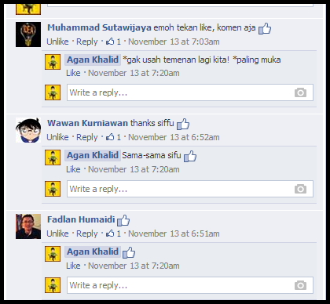
Threaded Comment

Slide 21
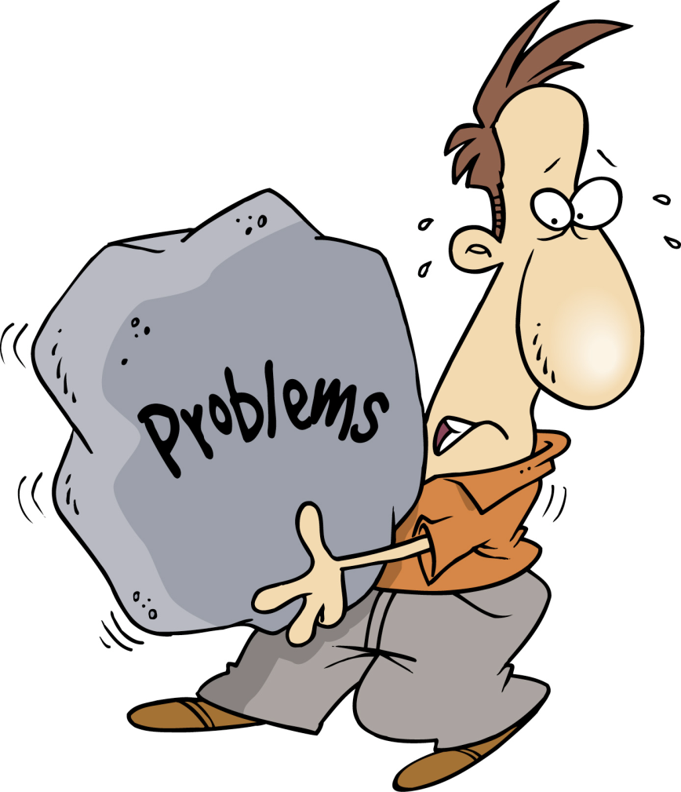

Slide 22
Edgerank

Slide 23
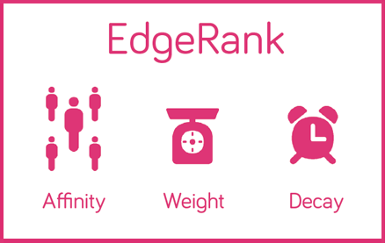
http://fbwithagankhalid.com/apa-itu-edgerank/

Slide 24
Elements
Photo
Call to Action
Choose “Call to Action”
Short Post

Slide 25

Photo

Slide 26


Slide 27
Example:
Klik like jika Anda …
Comment “Yes” jika Anda setuju …
Klik share jika Anda …
Begitu Lihat Foto ini, apa “Comment” Anda?
Klik “Like” & “Share” Jika …

Slide 28
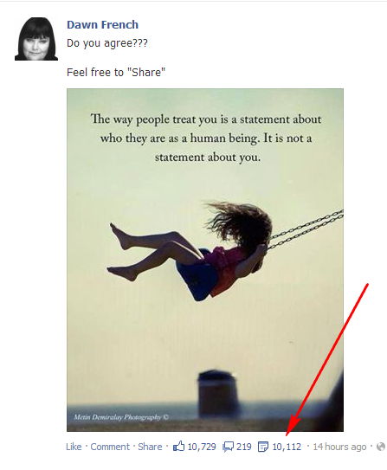

Slide 29
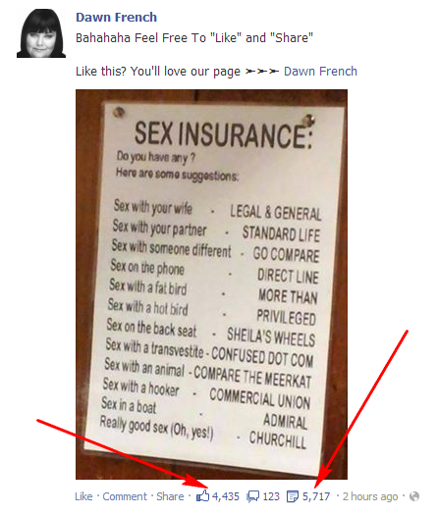

Slide 30
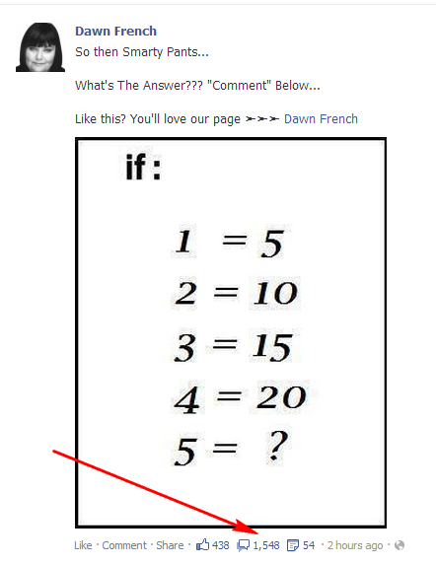

Slide 31
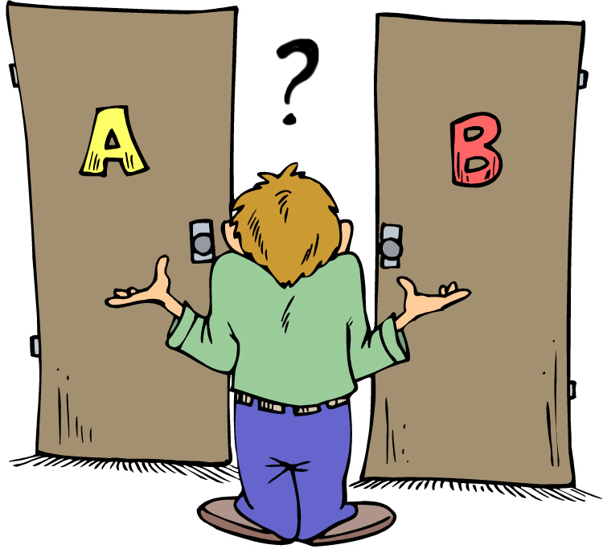
Choose Call to Action

Slide 32
Example
Klik “Like” Jika Anda Pilih A. Klik “Share” Jika Anda Pilih B.
“Like” Jika Anda Cinta Ibumu. “Share” Jika Anda Cinta Bangeeeeeeet Ibumu!
Mana Yang Anda Pilih (Foto).

Slide 33
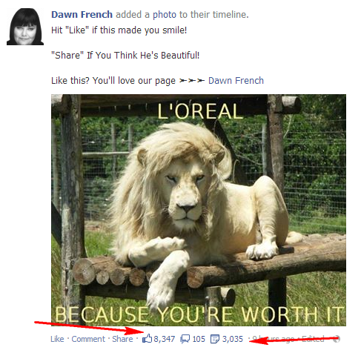

Slide 34
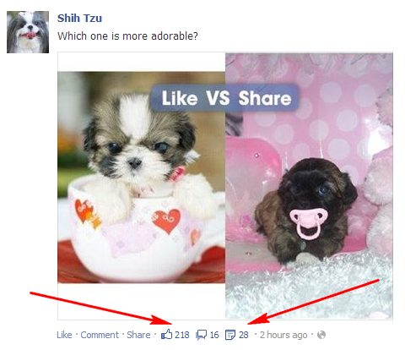

Slide 35
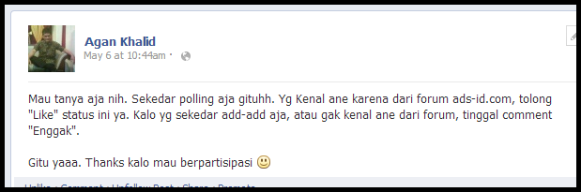

Slide 36
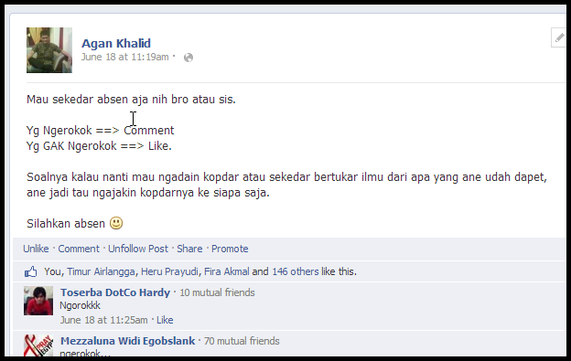

Slide 37
Short Post
100-250 Character

Slide 38
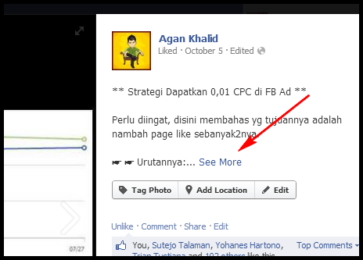

Slide 39
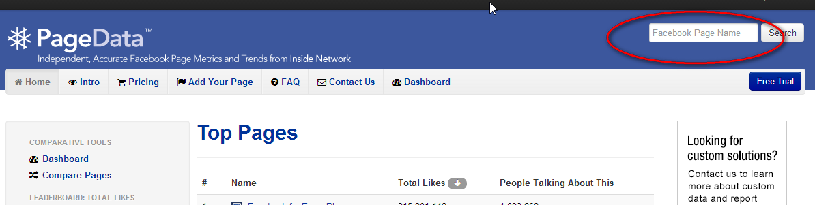
Ide Postingan
Kompetitor Yang sudah Anda ketahui
Kompetitor mencari lewat PageDataPro.Com

Slide 40
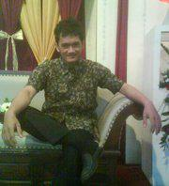
Tanya Jawab
ProdukAganKhalid.Com
FBWithAganKhalid.Com
SEOWithAganKhalid.Com

Slide 41

2 Bonus Tipe Postingan

Slide 42

Caption

Slide 43
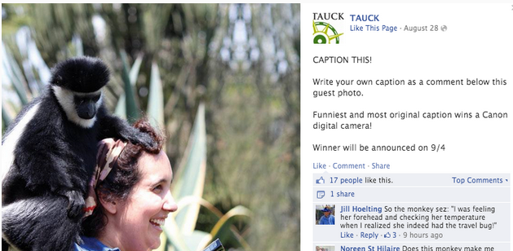

Slide 44
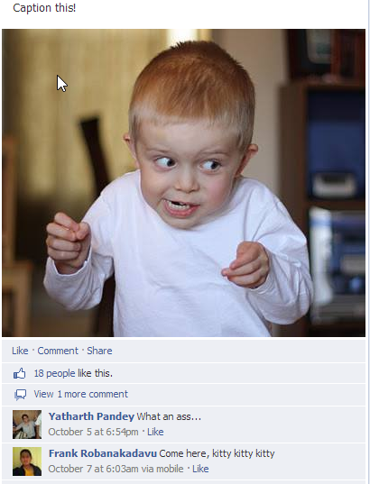

Slide 45
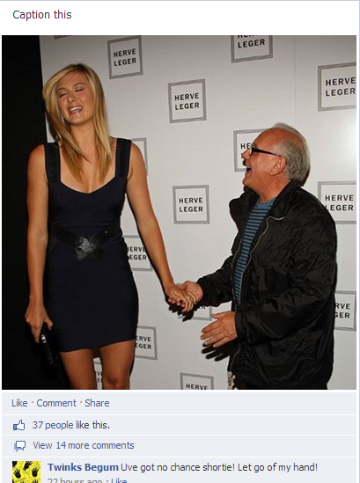

Slide 46


Slide 47
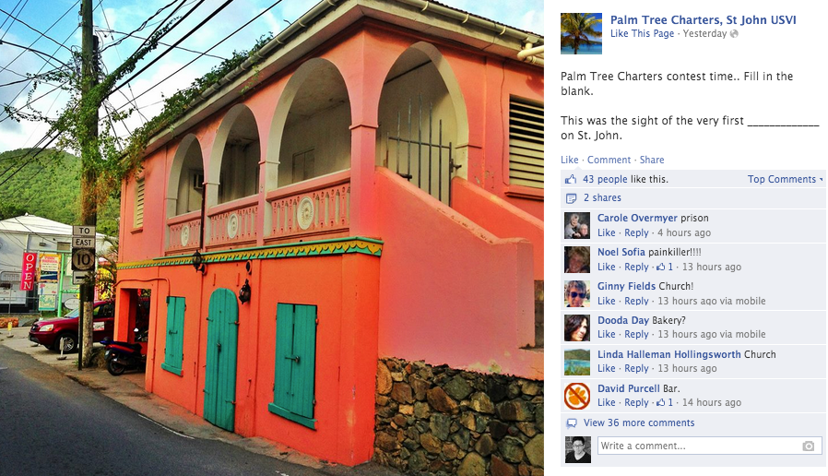

Slide 48
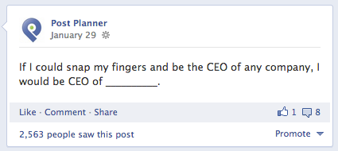

Slide 49
Tanya Jawab & Terimakasih
ProdukAganKhalid.Com
FBWithAganKhalid.Com
SEOWithAganKhalid.Com

Slide 50
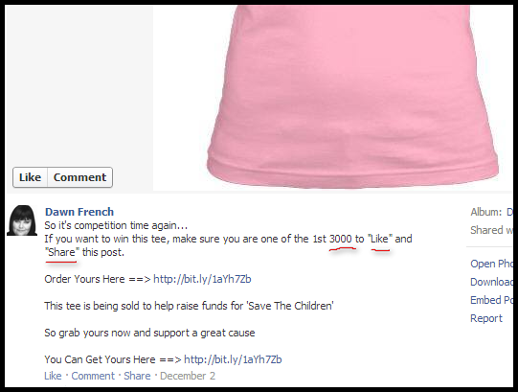
Source:
Tokopedia.Com

